Slide 1
Eliot Spitzer
“Hubris was terminal”

Slide 2
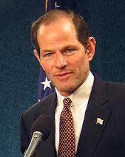
To begin…
Notes:
Eliot Laurence Spitzer (born June 10, 1959) is an American lawyer, political commentator, and Democratic Party politician. He most recently ran as a candidate for New York City Comptroller, losing the Democratic nomination to Scott Stringer. He served as the 54th Governor of New York from January 2007 until his resignation on March 17, 2008, which occurred in the aftermath of a prostitution scandal.

Slide 3
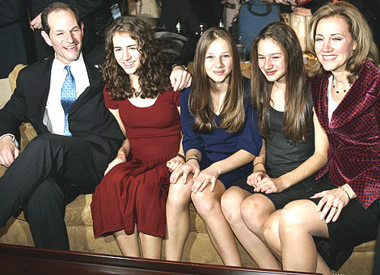
The assent
Princeton and Harvard Law
Married Silda Wall

Slide 4
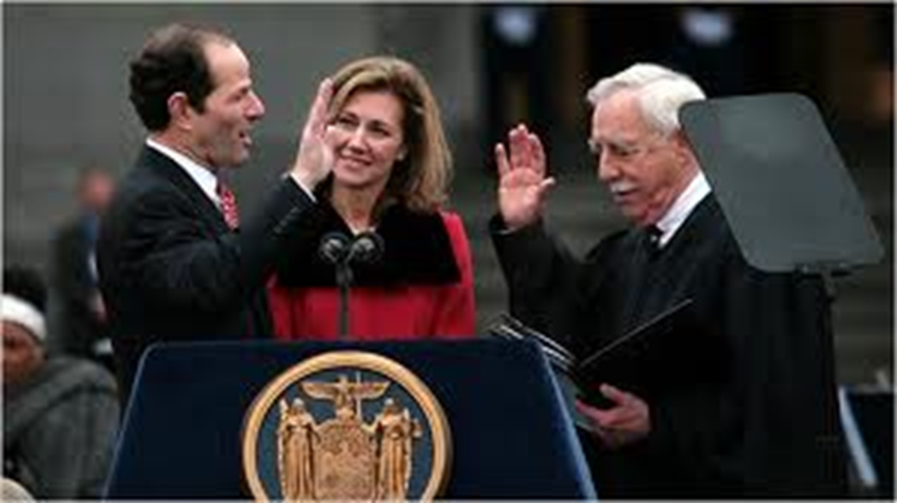
Professional Accomplishments
Private law firms
Manhattan District Attorney’s office
New York State Attorney General
Governor of New York
Notes:
He went on to work for the law firm of Paul, Weiss, Rifkind, Wharton & Garrison, and subsequently the Manhattan District Attorney's office to pursue organized crime. He launched the investigation that brought down the Gambino crime family's control over Manhattan's garment and trucking industries.
As attorney general, Spitzer prosecuted cases relating to corporate white collar crime, securities fraud, internet fraud and environmental protection.
During his time as attorney general, Spitzer brought major cases against some of the country's largest corporate giants. He also brought at least two cases against alleged prostitution rings and, as governor, signed legislation to increase penalties for international sex trafficking.

Slide 5
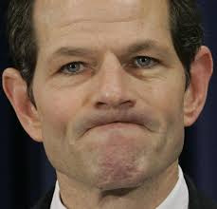
The Fall
Prostitution Scandal
Spitzer Resigns
Notes:
On March 10, 2008, The New York Times reported that Spitzer had previously patronized a high-priced prostitution service called Emperors Club VIP. According to published reports, investigators believe Spitzer paid up to $80,000 for prostitutes over a period of several years while he was Attorney General, and later as Governor. The scandal prompted him to resign as Governor on March 17.

Slide 6
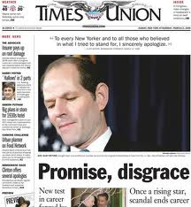
The aftermath
Cable news
A run for public office
And this…
Notes:
He most recently ran as a candidate for New York City Comptroller, losing the Democratic nomination to Scott Stringer. On May 31, 2013 Eliot and his wife were reported to be living apart.

Slide 7
Work Cited
"Eliot Spitzer." Wikipedia. Wikimedia Foundation, 11 Jan. 2013. Web. 01 Nov. 2013.
MICHELS, SCOTT. "Tough Words Come Back to Haunt Spitzer." ABC News. ABC News Network, 10 Mar. 2008. Web. 01 Nov. 2013.

